Slide 1


2nd GODEX-NWP meeting:
Météo-France status report
Jean-François Mahfouf and many colleagues
CNRM/GMAP/OBS (Toulouse, France)

Slide 2
Outline
Computing platform
Model configurations
Use of observations
Recent operational changes
Ongoing developments and future plans

Slide 3
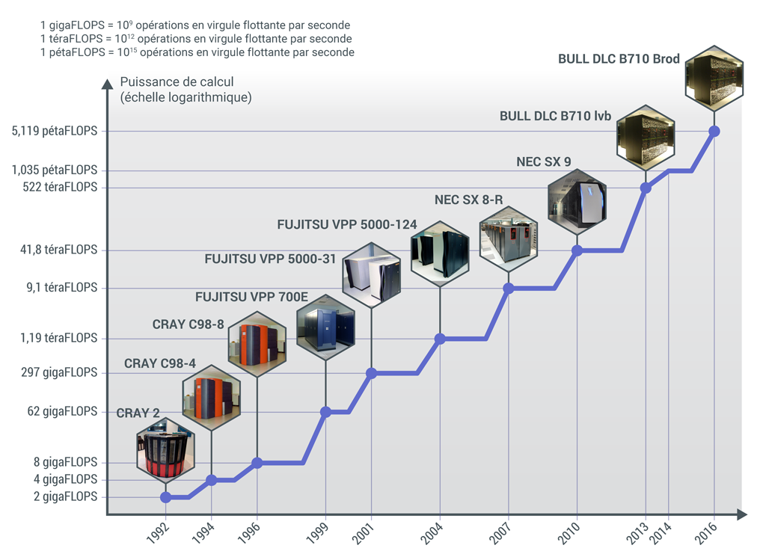
Evolution of HPC at Météo-France
Page 3

Slide 4
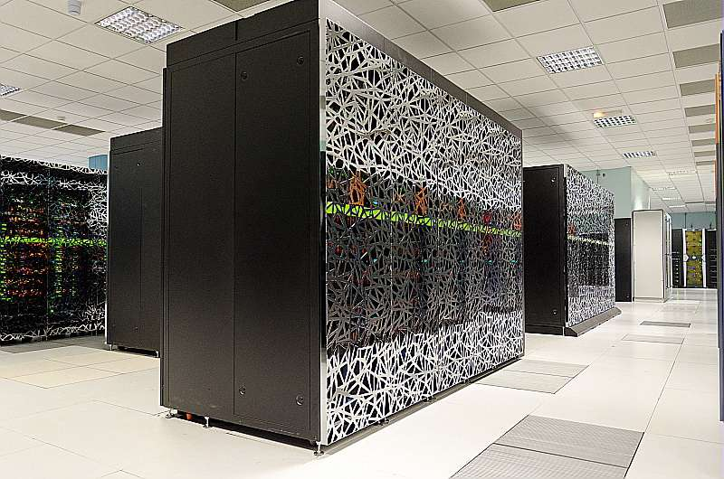
Super-computers at Météo-France
Initial configuration (2013)
2 x 1000 nodes
1 node = 24 CPUs
Intel « Ivy Bridge »
50 000 cores / 1 Pflops
Last upgrade (2016):
2 x 1800 nodes
1 node = 40 CPUs
Intel « Broadwell IP »
150 000 cores / 5 Pflops
2 x BULL B710 DLC
1 cluster for operations (ECA)
1 cluster for research (CNC)
New HPC (x 3.5) by mid-2020

Slide 5
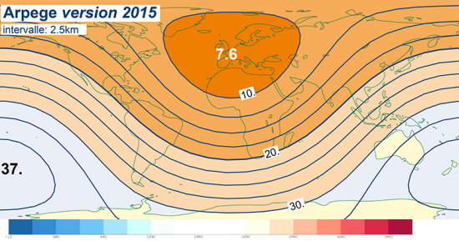
Global model ARPEGE (high resolution)
Spectral model with
variable resolution:
T_{L}1198c2.2L105
# Δx from 7.5 to 36 km
# 105 vertical levels from 10 m to 0.1 hPa
Incremental 4D-Var assimilation (6-h window and 30 min time-slots) :
2 loops of minimization: T_{L}149c1L105 (40 iterations) + T_{L}399c1L105 (40 iterations)
Background error variances and correlation lengths from an EDA system (4D-Var at lower resolution: T_{L}479/T_{L}149) with 25 members (AEARP)
Forecasts (cut-off and ranges):
00 UTC (1h10/54h), 00 UTC (2h15/102h),
06 UTC (3h/72h), 12 UTC (1h50/144h), 18 UTC (3h/60h)
Notes:
Donner les résolutions horizontales associées aux diverses troncatures

Slide 6
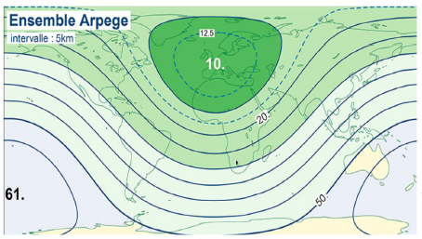
Global model ARPEGE (ensemble)
Spectral model with
variable resolution:
T_{L}798c2.4L90
# Δx from 10 to 60 km
# 90 vertical levels from 14 m to 1 hPa
35 members: 1 control + 34 perturbed analyses (PEARP)
Initial conditions: 17 members from the AEARP + singular vectors over 7 areas
Model uncertainties: 10 different physical packages (moist convection, radiation, gravity wave drag)
Forecasts ranges:
00 UTC (48 h), 06 UTC (90 h),
12 UTC (48 h), 18 UTC (108 h)
Notes:
Donner les résolutions horizontales associées aux diverses troncatures

Slide 7
Changes in observation usage (12/2017)
Thinning of IASI radiances 125 km -> 100 km
2 channels @ 183 GHz from GMI/GPM
3 channels @ 183 GHz from MWHS-2/FY-3C
Thinning of CSR from GEO 250 km -> 125 km
4 window channels over oceans from METEOSAT-8 and -10
Page 7

Slide 8
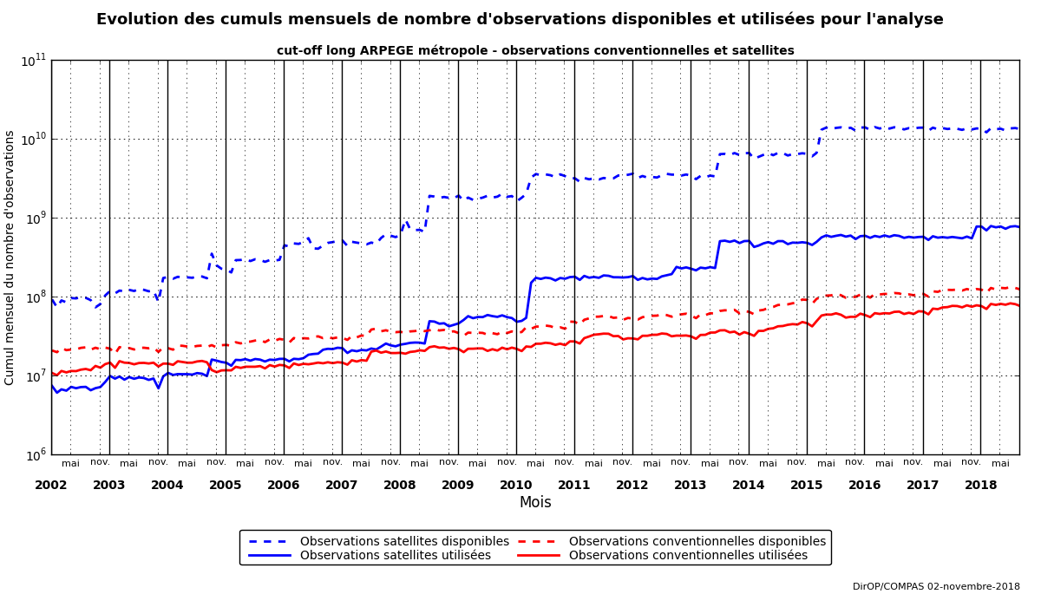
Observation evolution in ARPEGE
available
CONV
SAT
used

Slide 9
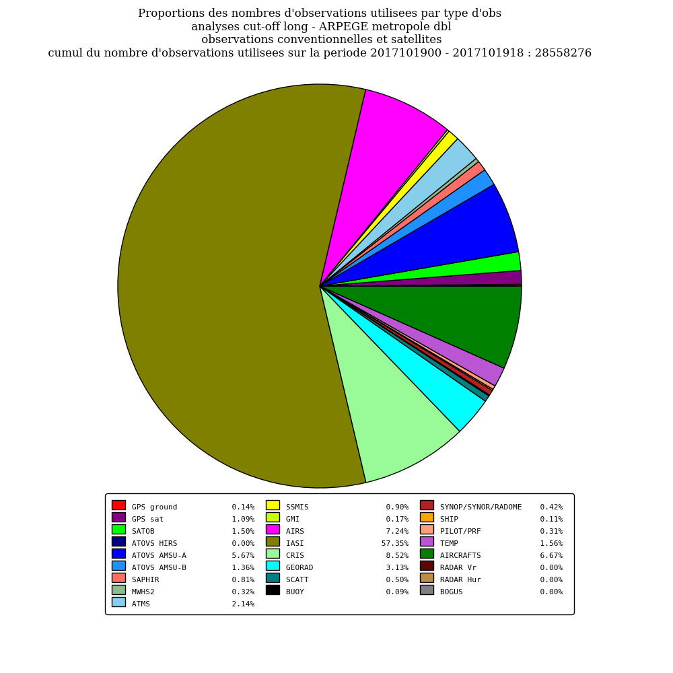
Observations in ARPEGE
Satellite observations (90 %)
-> Infra-red radiances (70 %)
IASI (METOP-A + B)
CrIS/Suomi-NPP / AIRS/Aqua
CSR from GEO satellites
-> Microwave radiances
AMSU-A (NOAA/Aqua/METOP)
MHS (NOAA/METOP)
ATMS (Suomi-NPP)
SSMI/S (DMSP F17/F18)
SAPHIR (Megha-Tropiques)
-> GNSS-RO + GB
-> AMVs + Scatterometer winds
Conventional observations (10 %)
-> Aircrafts, surface, RAOB
28 x 10⁶/day
IASI
IASI
Fraction of observation types (since 12/2017)
Spatial thinning of satellite obs between 250 and 100 km

Slide 10
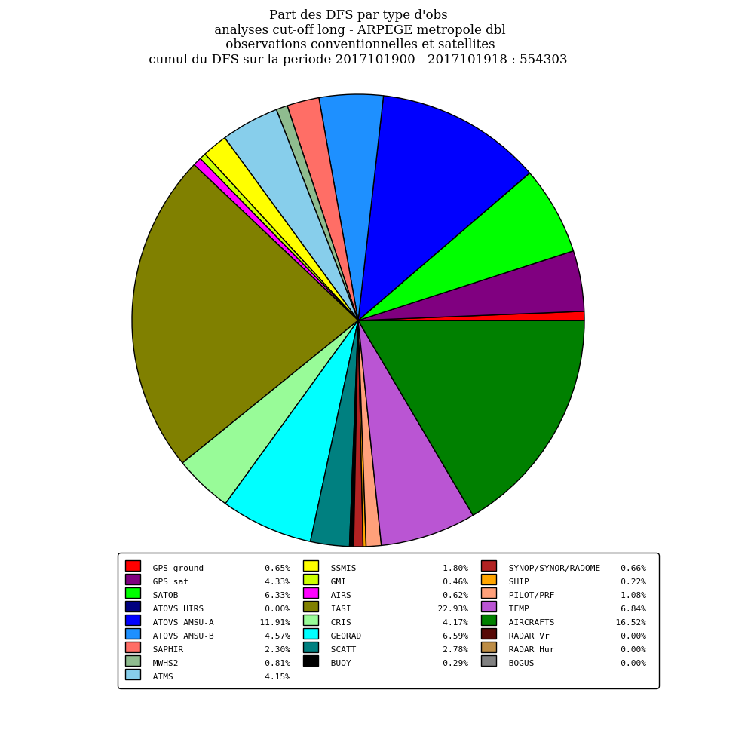
Observations in ARPEGE
IR 73 %
MW 12%
IR 28 %
MW 26 %
IASI
Fraction of observation types
(conv = 9 %)
DFS: information content
(conv = 25%)

Slide 11
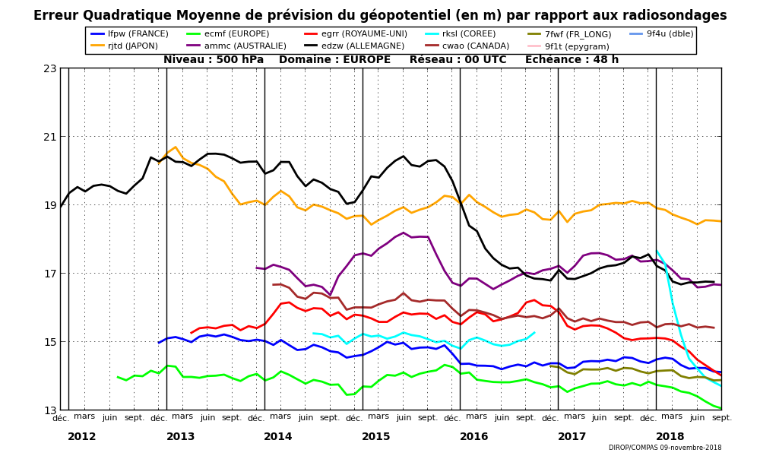
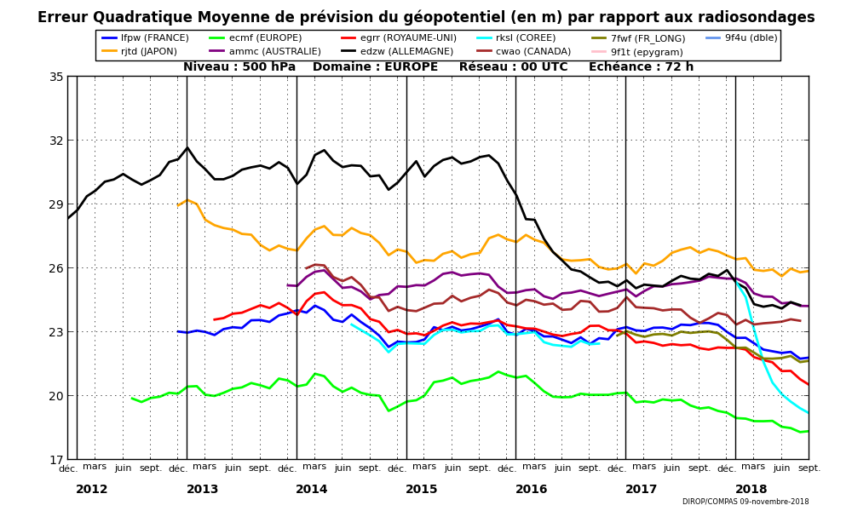
Forecast scores for ARPEGE (Z @ 500hPa)
Météo-France
ECMWF
MetOffice
DWD
Europe 48 h
Europe 72 h
Page 11

Slide 12

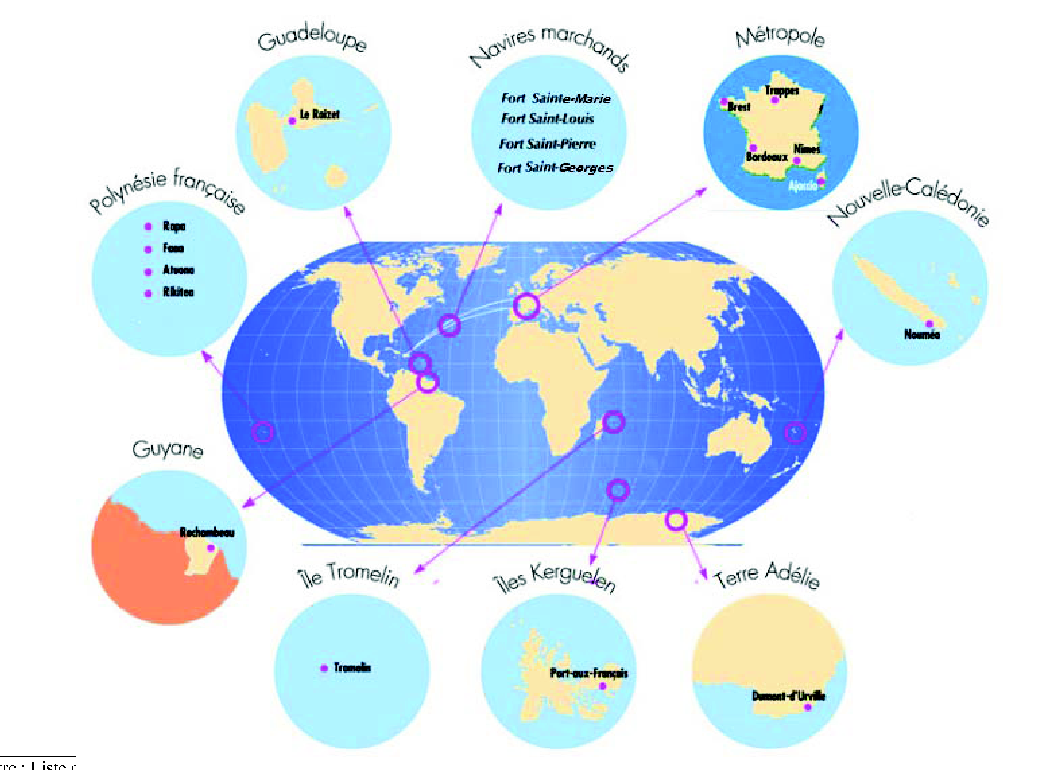
The MF upper air network (2018)
@ Threat !
EUMETNET-ASAP
5 automatic
19 RS

Slide 13
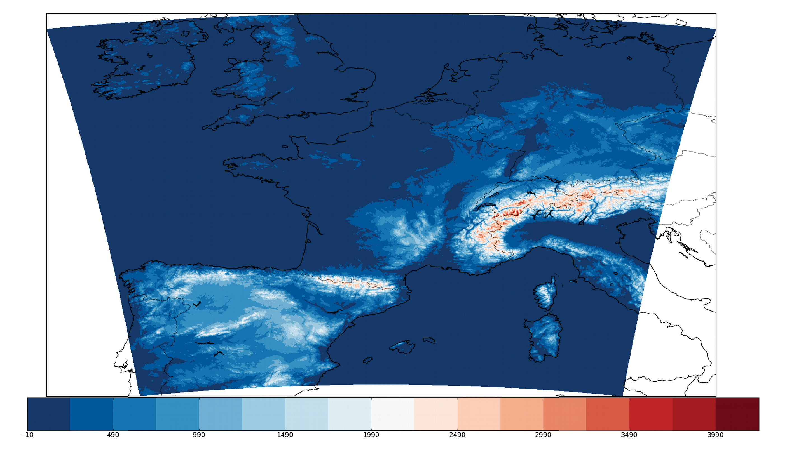
Regional model AROME (France)
Spectral limited area non-hydrostatic model with explicit moist convection (since 12/2008)
Horizontal resolution: 1.3 km (*)
90 vertical levels (from 5 m up to 10 hPa) (*)
3D-Var assimilation (1-h window) + IAU (*)
Same observations as in ARPEGE:
(+) radar Z (RH) & DOW (8 km) – raw SEVIRI radiances (NWC-SAF cloud mask + LSA- SAF emissivity atlas)
(-) GNSS-RO – CrIS and AIRS radiances
Forecast range : from 7 to 48 hours (8 times a day) – cut-off: between 20 min and 3.5 h
Nowcasting version (operational since 04/2016) :
  forecasts up to 6 h issued every hour (assimilation not cycled)
  Assimilation window [-10 min, + 10 min]
  Cut-off : 10 min
(*) since 04/ 2015
Notes:
Vérifier les cut-offs d’AROME

Slide 14
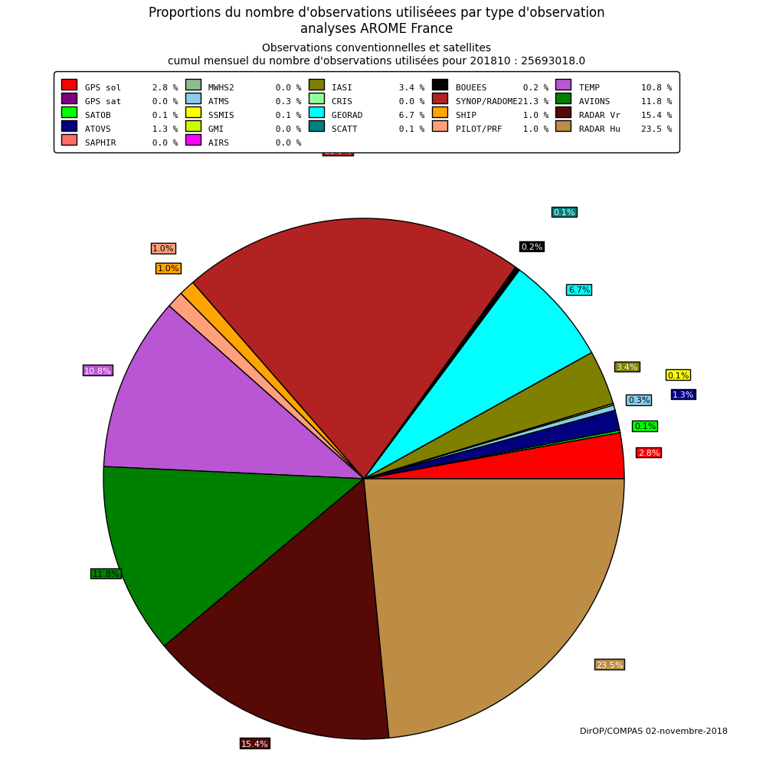
Observations in AROME 3D-Var
Satellite observations = 12 %
Radar DOW + Z (RH)
Surface (SYNOP + RADOME)
Radiosoundings (BUFR HR)
Aircrafts
GEO radiances (METEOSAT)
LEO satellites (IASI, AMSU, AMVs, SCAT)
Ground based GNSS (ZTD)
Spatial thinning of satellite obs
between 80 and 125 km
Data availability for AROME-NWC : radar, surface, IASI, AMSU-A/MHS radiances (from Lannion) and ASCAT winds (from EARS)

Slide 15
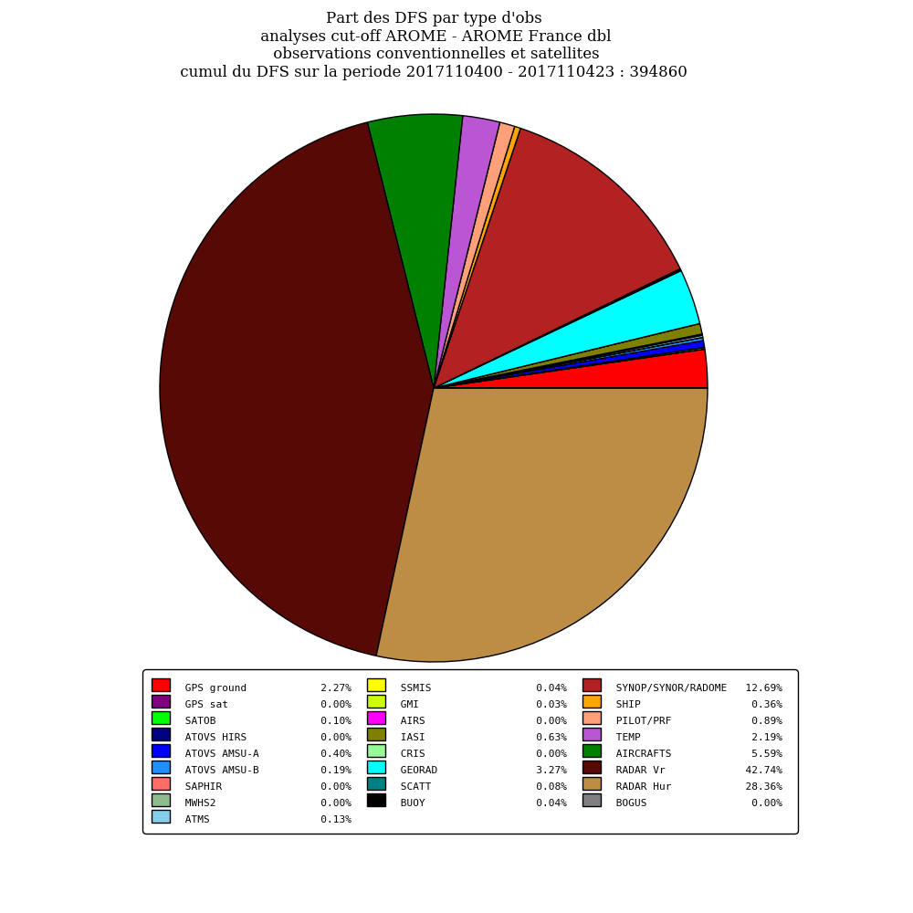
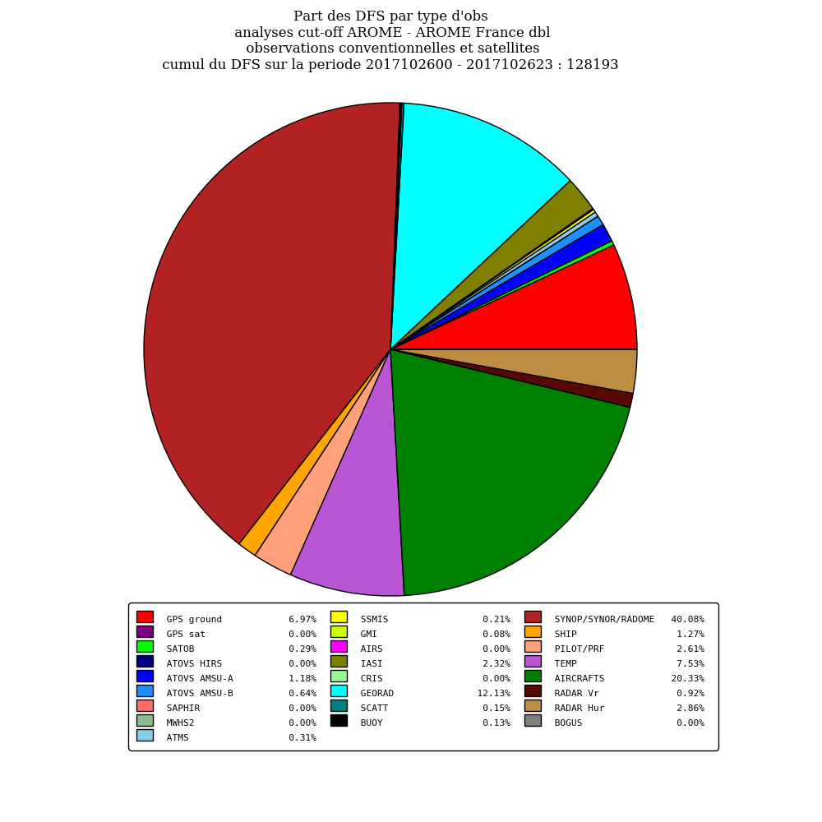
Information content of observations
Surface
Radar Vr
Radar RH
Aircrafts
Rainy period
Dry period

Slide 16
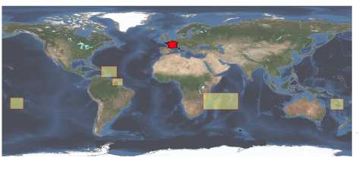
Regional model AROME (overseas)
5 domains :
CARABBIAN
GUYANA
REUNION
NEW CALEDONIA
FRENCH POLYNESIA
Horizontal resolution : 2.5 km - 90 vertical levels
Coupling with a 1D- mixed layer ocean model (SST prediction)
Initial conditions from ECMWF (altitude) – ARPEGE (surface) => introduced using an IAU algorithm in the previous 6-h forecast
Coupling files : hourly forecasts from IFS (ECMWF)
Forecast ranges : from 36 to 42 hours (twice a day)
Notes:
Vérifier les cut-offs d’AROME

Slide 17
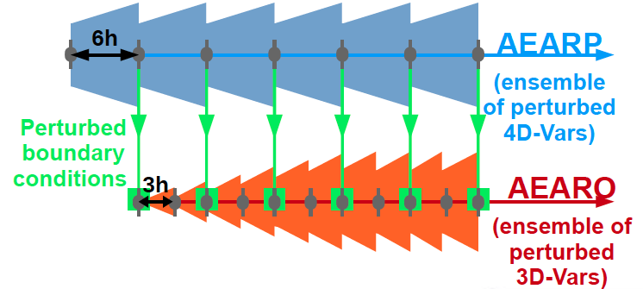
Regional model AROME (ensemble)
Ensemble Prediction System with 12 members @ 2.5 km / 90 levels
Sources of uncertainties :
  Initial conditions (AEARP perturbations -> AEARO)
  Lateral boundary conditions (PEARP)
  Model uncertainities : surface and stochastic physics
Forecast ranges : 09 and 21 UTC (51 h) – 03 and 15 UTC (45 h)
Ensemble Data Assimilation System with
25 members @ 3.25 km
3D-Var (3-h) perturbed observations
LBC : AEARP
Notes:
Vérifier les cut-offs d’AROME

Slide 18
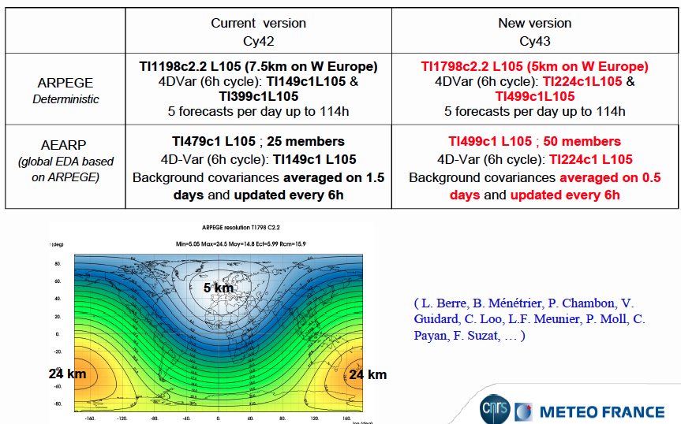
Current e-suite (operational in 02/2019)
Page 18

Slide 19
Changes in observation usage (02/2019)
Inter-channel correlations of observation errors for IASI and CrIS hyperspectral sounders
IASI low peaking channels over continents (emissivity atlas + T_{s} retrieval)
Revised microwave emissivity atlases over continents (monthly)
Variational bias correction for ground-based GNSS
AMVs from GOES-16
Ocean winds from Ku band OSCAT scatterometer on board ScatSat-1
Monitoring of AMSR-2/GCOM-W1 and MWRI/FY-3C radiances
Monitoring of bending angles from GNOS/FY-3C and ROSA/MT
Monitoring of OPERA radar winds and reflectivities (AROME)
Page 19

Slide 20
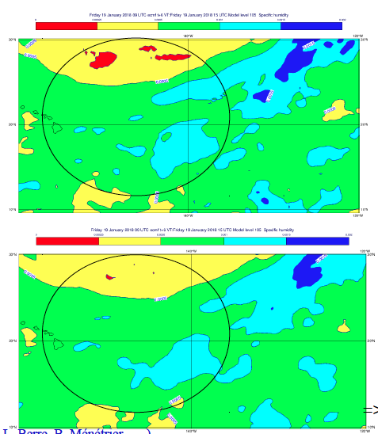
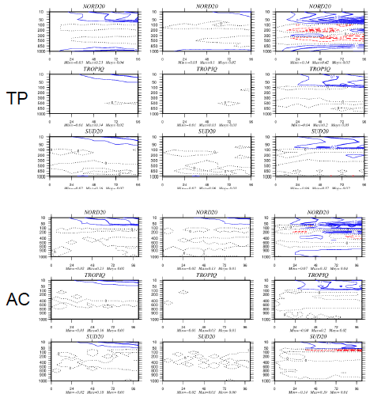
Current e-suite (CY43T2) – illustrations
Changes to the physics: tuning of convection scheme to prevent grid point storms
Changes to the dynamics: increase horizontal diffusion for wind in the stratosphere (cold bias)
Impact of 50 members in EDA on humidity backgound errors (q 1000 hPa)
N20
25
Tropics
T scores
2 months
☺
☹
S20
N20
50
Tropics
S20
Page 20

Slide 21
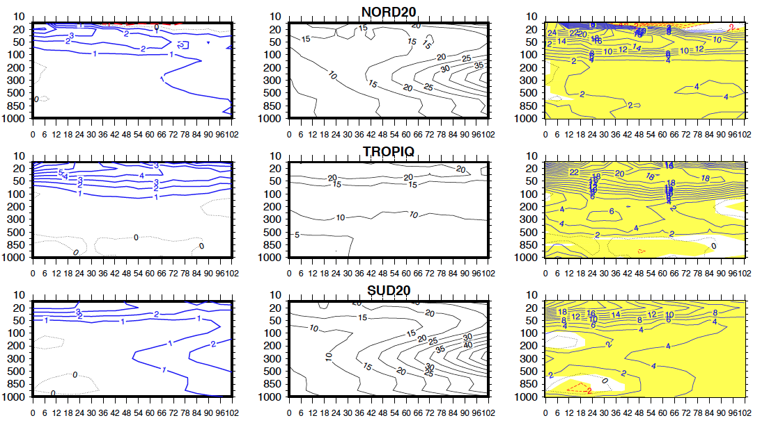
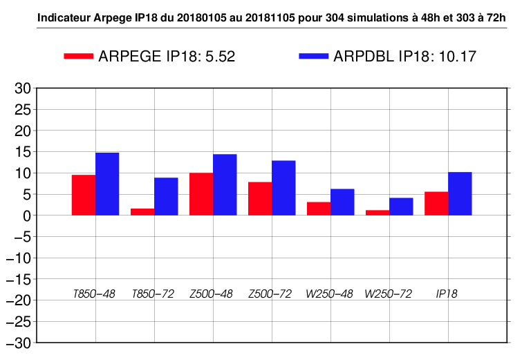
Current e-suite (CY43T2) – forecast scores
☺ ☹
significant
Z scores wrt
ECMWF analyses
316 cases
RMSE(oper)-RMSE(expe)
RMSE(oper)
100*
(RMSE(oper)-RMSE(expe))
/RMSE(oper)
NWP index over Europe (306 cases)
OPER
EXPE
Page 21

Slide 22
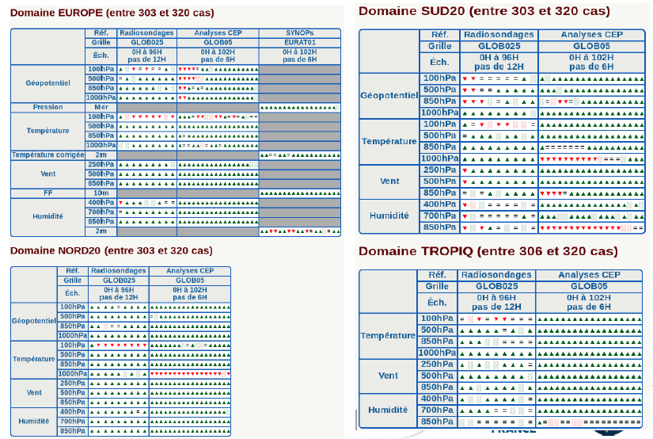
Current e-suite (CY43T2) – score cards
Page 22

Slide 23
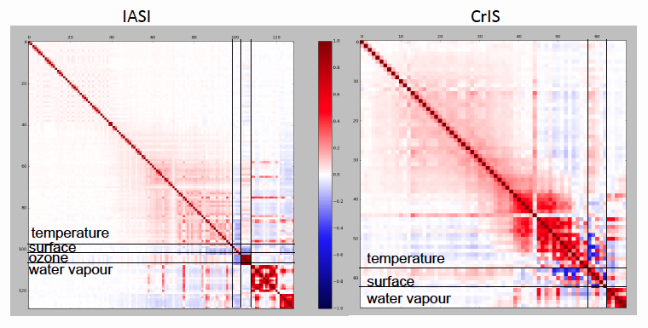
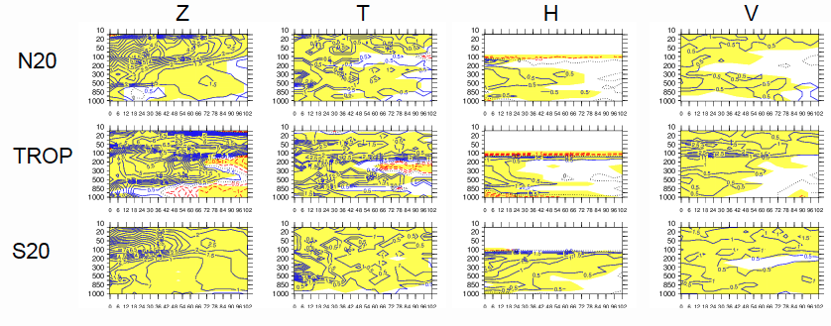
IASI and CrIS inter-channel correlations
Diagnosed correlations
from Desroziers method
No changes to σ_{o}
Positive scores ☺
Page 23

Slide 24
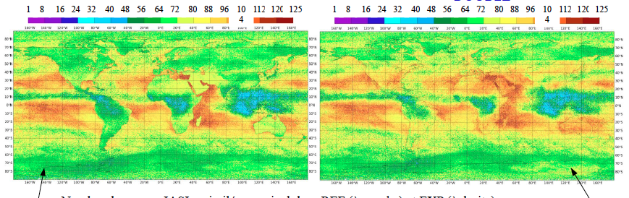
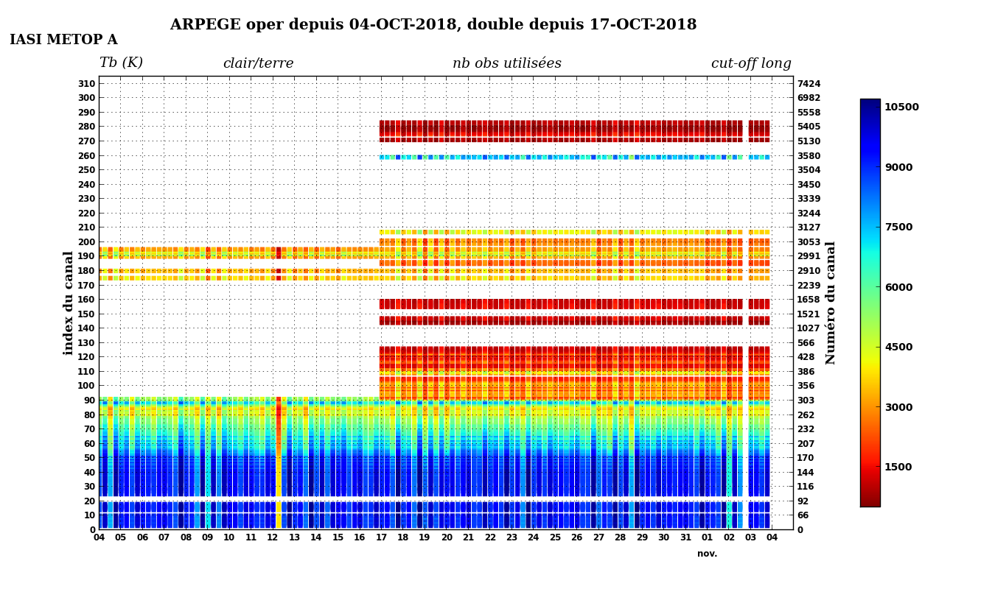
Increase of IASI channels over continents
123 channels over sea
77 channels over land
123 channels over sea
122 channels over land
Page 24

Slide 25
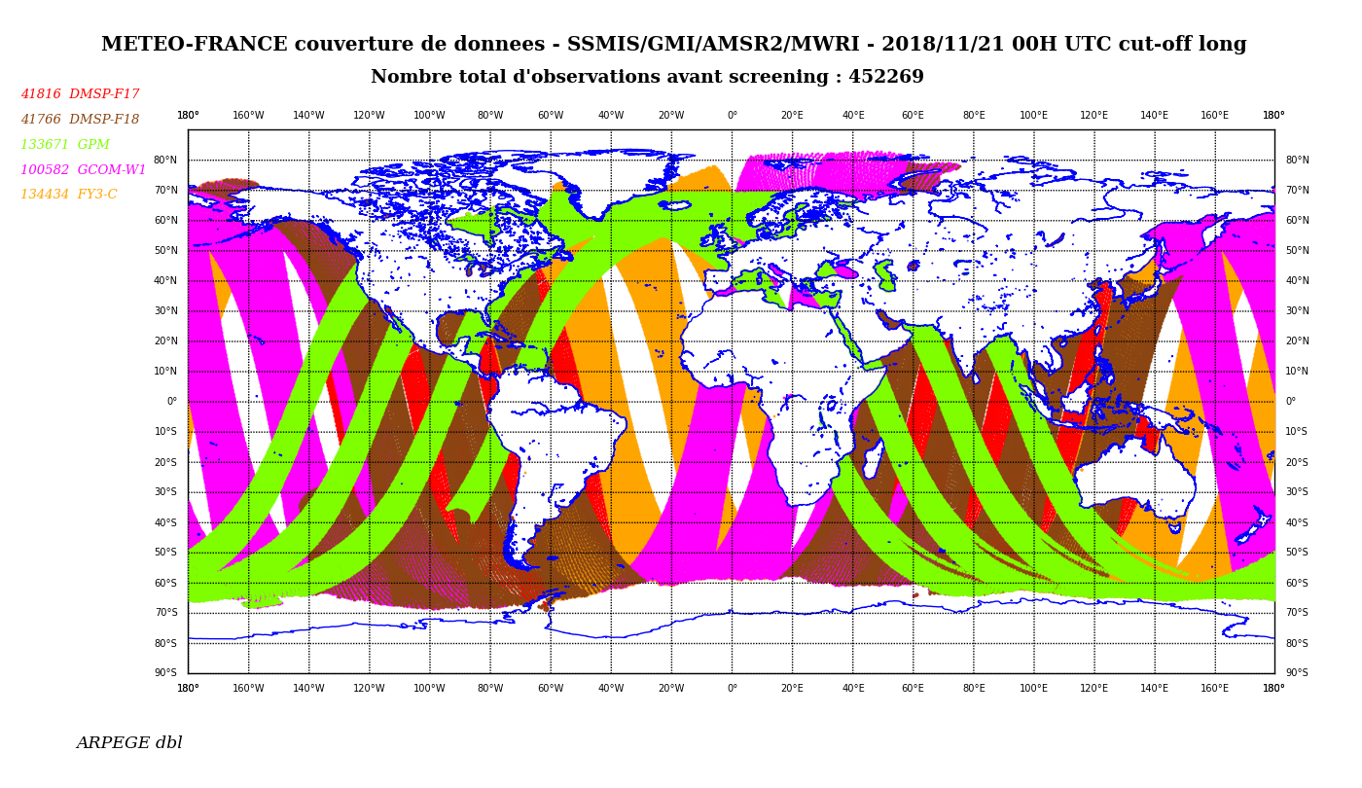
Monitoring of MW conical scan radiometers
New ones:
AMSR-2
MWRI
Page 25

Slide 26
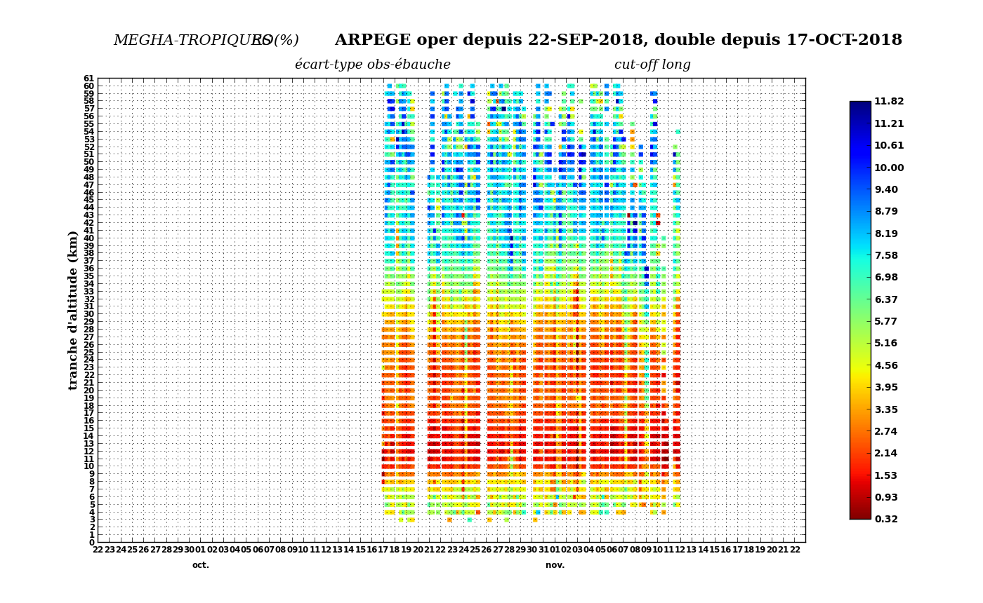
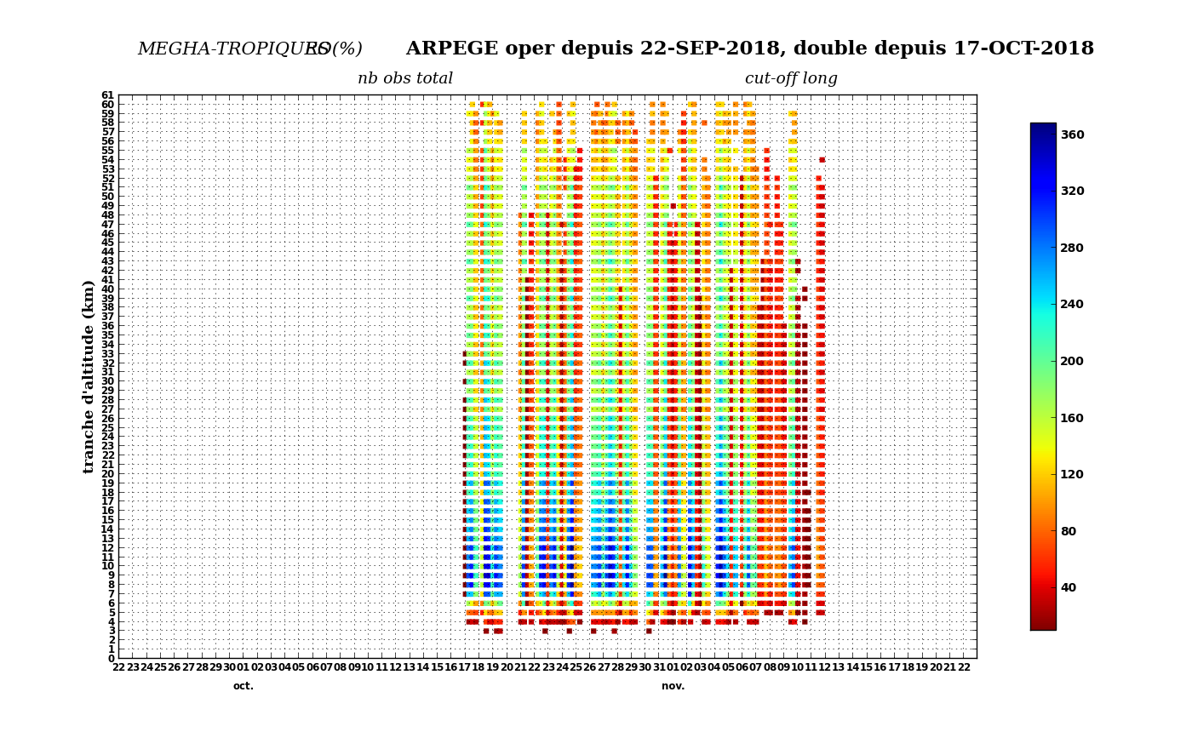
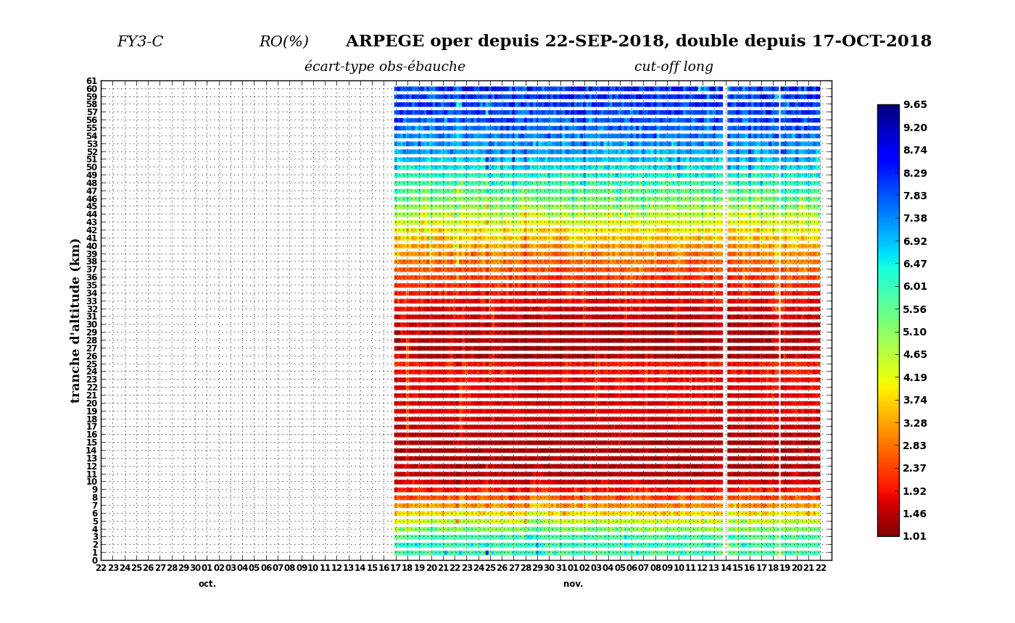
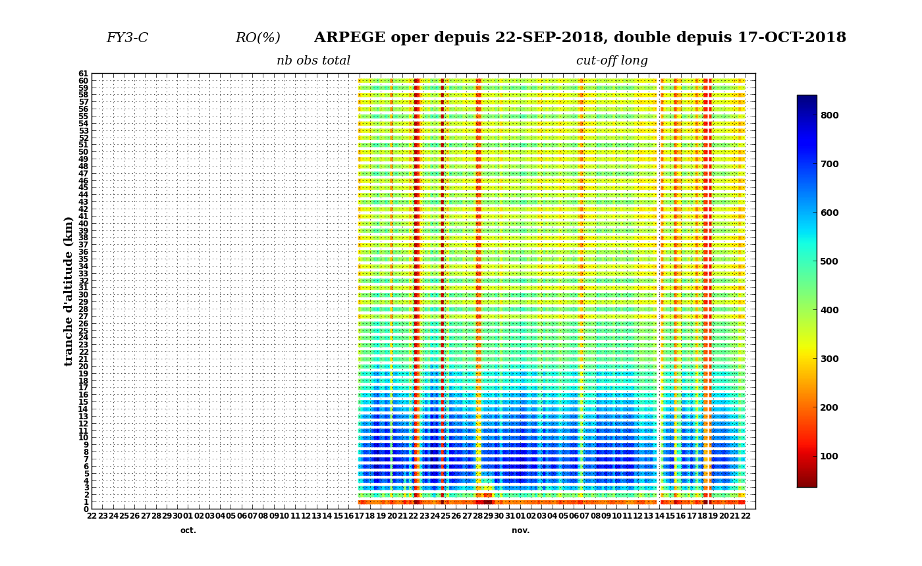
GNSS-RO monitoring (current e-suite)
ROSA
Std(O-B)
ROSA
Nb obs
GNOS
Std(O-B)
GNOS
Nb obs
17 October 2018 -> 22 November 2018
Page 26

Slide 27
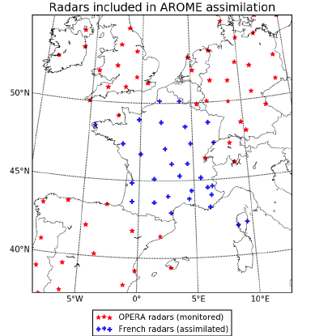
Additional European radars for AROME
30 radars from French network
62 additional European radars
(some on them located outside
the AROME domain) available
from EUMETNET OPERA
Monitoring in AROME
Page 27

Slide 28
Recent difficulties @ MF with observations
Involvement in the preparation of MW instruments that have been discontinued: SSMI/S on board DMSP-F19, MTVZA-GY on board Meteor-M N
Difficulties to get positive impacts from the assimilation of new microwave sensors (AMSR-2, GNSS-RO, ScatSat-1)
Availability of new satellite data from EUMETCast: EUMETCast HVS antenna not yet installed in Toulouse to receive NOAA-20 and METOP-C data
Differences between CrIS/S-NPP (nominal spectral resolution) and CrIS/NOAA-20 (full spectral resolution) prevent us from assimilating the two instruments => need to have CrIS/NOAA-20 in NSR (conversion FSR2NSR using AAPP ?)
Lack of CSR on GOES-16 -> collaboration with CMS/Lannion to get thinned raw radiances from ABI with NWC SAF cloud classification
Page 28

Slide 29
Plans for new observation types
Assimilation of monitored observations (MW radiances / GNSS-RO)
ATMS and CrIS from NOAA-20
AMSU-A, MHS, IASI, ASCAT and GRAS from METOP-C
HLOS from AEOLUS (+ studies with L2B processor)
SCAT from CFOSAT mission (use info from SWIM ?)
GNSS-RO from COSMIC-2A
AMVs and CSR (?) from GOES-17
All-sky radiances from SAPHIR using 1D-Bayesian + 4D-Var
Specific observations for AROME:
  European radars from OPERA
  French radar data from a new unified processing chain
  Aircraft winds from MODE-S/ADS-B reception
  Humidity aircraft observations (AMDAR-q)
  Tropospheric gradients from ground-based GNSS
  Polarimetric radar variables
=> re-tuning of observation errors with the recent NWP system
Page 29

Slide 30
Other studies
Development of Ensemble Variational Data Assimilation systems for ARPEGE and AROME => suitable observation diagnostics
Increased usage of existing observations
    Assimilation of IR and MW radiances in cloudy and precipitating areas for ARPEGE and AROME (=> improved data assimilation algorithms)
Preparation of future satellite missions
  Hyperspectral infrared geosounder IRS/MTG (launch in 2023) -> low model top issue, channel selection, OSSEs
  IR (IASI-NG) and MW (MWS/MWI/ICI + SCA/GNSS-RO) instruments on board METOP-SG (launch in 2022)
  Feasibility studies on future potential instruments (microwave geosounder, hyperspectral microwave sounder, constellations of nano-satellites*, …)
* Presence of private companies
Page 30

Slide 31
Thank you for your attention !

